Slide 1
Multi-user Systems
Communication Theory Project
Sasanka GRS (2019112017)
Pranjali Pathre (2019112002)
Pragya Singhal (2019112001)
Abhishek Chawla (2019102020)
Chirag Shameek Sahu (2019102006)

Slide 2
MULTIPLE ACCESS PROTOCOLS
Dedicated channels allocated to users are called multiple access.
These techniques divide up the total signalling dimension into channels and then assign these channels to different users.
The various multiple access protocols are:
Frequency-division Multiple Access (FDMA)
Time-division Multiple Access (TDMA)
Code-division Multiple Access (CDMA)

Slide 3
Frequency-Division Multiple Access (FDMA)
Signaling dimensions are divided along the frequency axis into non-overlapping channels.
Each user is assigned a different frequency channel.
Each channel has a guard band, for imperfect filters, adjacent channel interference, and spectral spreading due to Doppler.
Transmission is continuous over time.
Difficult to assign multiple channels to the same user, since this requires the radios to simultaneously demodulate signals received over multiple frequency channels.
Most commonly used for analog communication.

Slide 4
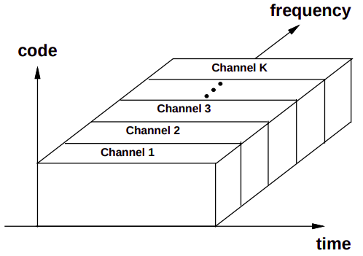
Representation of FDMA

Slide 5
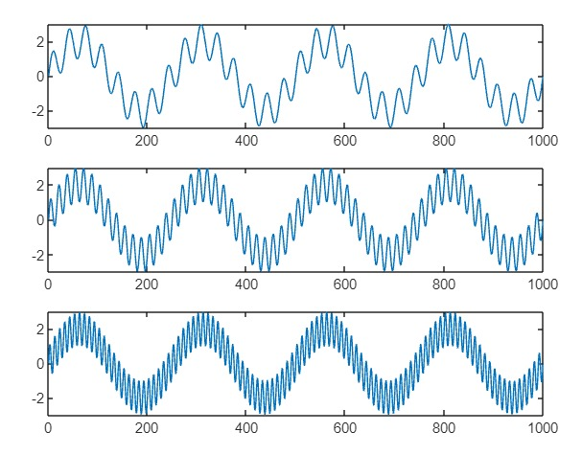
Frequency Allocation Bands for FDMA

Slide 6
Time-Division Multiple Access (TDMA)
Signalling dimensions are divided along the time axis into non-overlapping channels.
Each user is assigned a different cyclically-repeating timeslot.
Occupy entire bandwidth, which is wideband, requiring ISI mitigation.
Transmission is not continuous over time.
Advantage to assign multiple channels to a single user by assigning the user multiple time slots.
Difficulty in synchronization among the different users.
Another difficulty is with cyclically repeating timeslots, the channel characteristics change on each cycle.

Slide 7
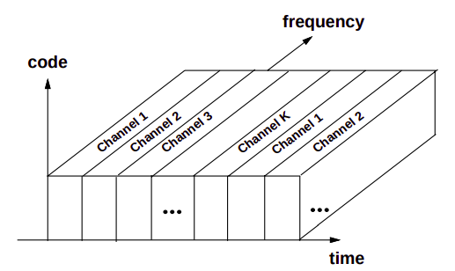
Representation of TDMA

Slide 8
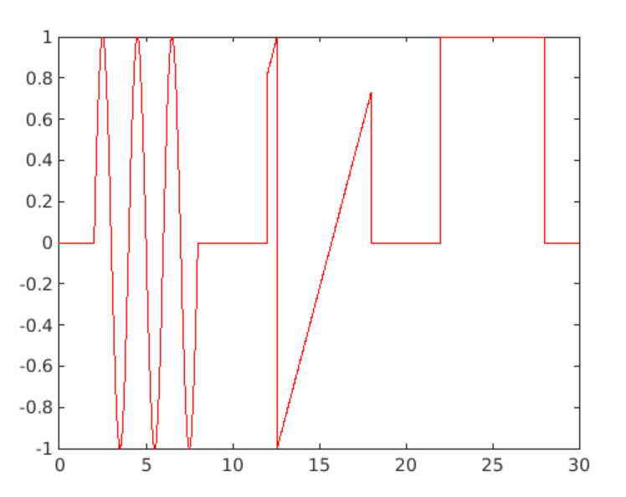

Slide 9
Code-Division Multiple Access (CDMA)
Information signals of different users are modulated by orthogonal or non-orthogonal spreading codes.
Resulting spread signals simultaneously occupy the same time and bandwidth.
Advantages of non-orthogonal CDMA is little dynamic coordination of users in time or frequency is required, as they are separated by code properties.
It is simple to allocate multiple channels to one user with CDMA by assigning that user multiple codes.
Commonly used in the IS-95, W-CDMA and CDMA2000 digital cellular standards.

Slide 10
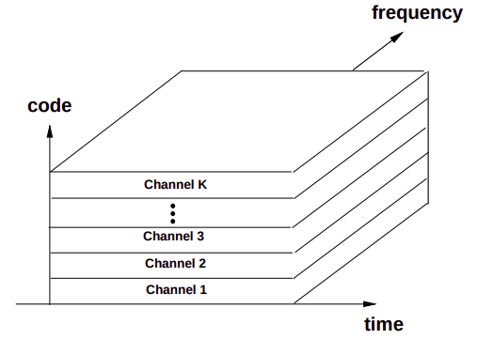
Representation of CDMA

Slide 11
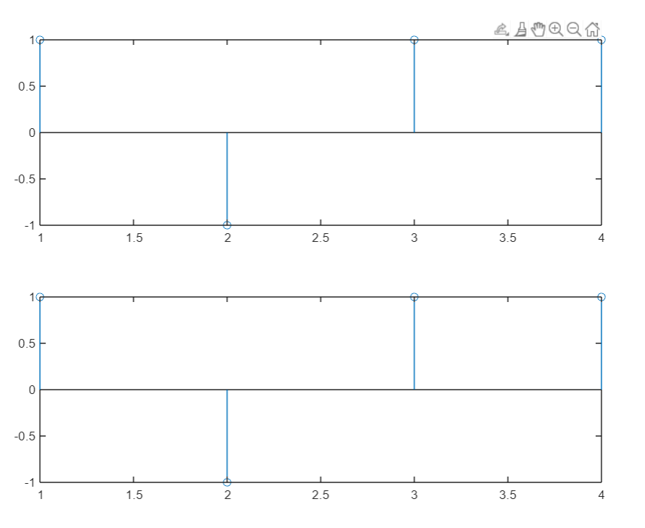
Data plot for random user
Figure 1 shows the actual data to be sent , Figure 2 shows the decoded data.

Slide 12
RANDOM ACCESS PROTOCOLS
Allocation of signaling dimensions for users with bursty transmissions generally use some form of random channel allocation which does not guarantee channel access.
Bandwidth sharing using random channel allocation is called random multiple access or simply random access.
There are 2 types of random access protocols:
ALOHA
Carrier Sense Multiple Access (CSMA)
Scheduling

Slide 13
Pure ALOHA
In pure ALOHA, when a frame (data packet) first arrives, the node immediately transmits the frame in its entirety into the broadcast channel.
If a transmitted frame experiences a collision with one or more other transmissions, the node will then immediately retransmit the frame with probability ‘p’.
Otherwise, the node waits for a frame transmission time.
After this wait, it then transmits the frame with probability ‘p’, or waits (remains idle) for another frame time with probability ‘1 – p’.

Slide 14
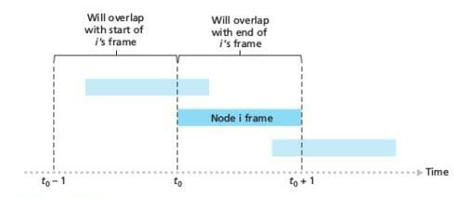

Slide 15
Slotted ALOHA
Time is assumed to be slotted in time slots of certain duration.
Nodes can only start their frame transmission at the beginning of the next time slot after the frame is formed.
When the node has a fresh frame to send, it waits until the beginning of the next slot and transmits the entire frame in the slot.
If there isn’t a collision, the node has successfully transmitted its frame and thus need not consider retransmitting the frame and prepares a new frame for transmission.
If there is a collision, the node detects the collision before the end of the slot.

Slide 16
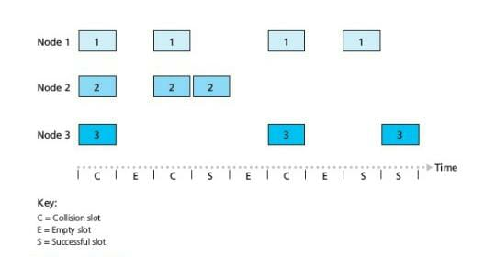

Slide 17
Throughput of pure and slotted ALOHA
In pure and slotted ALOHA, the probabilities of collisions are modelled as Poisson distribution. The probability that k-frame are generated during transmission is given as:
Success is considered to have occurred when the number of frames generated is 0.
In pure ALOHA, the time for no collisions is 2 time slots. While in, slotted ALOHA, it is 1. Thus probability of success is P(X(t)=0).
The throughput is the number of transmission attempts with a success. Thus, throughput T is given as: T = Lp

Slide 18
For pure ALOHA
For slotted ALOHA,
The maximum throughput can be obtained by finding the derivative with respect to L and equating to 0.
Hence, the maximum throughput of pure ALOHA is obtained to be 1/2e that is approximately 0.18 (18% efficiency).
Hence, the maximum throughput of slotted ALOHA is obtained to be 1/e that is approximately 0.36 (36% efficiency).

Slide 19
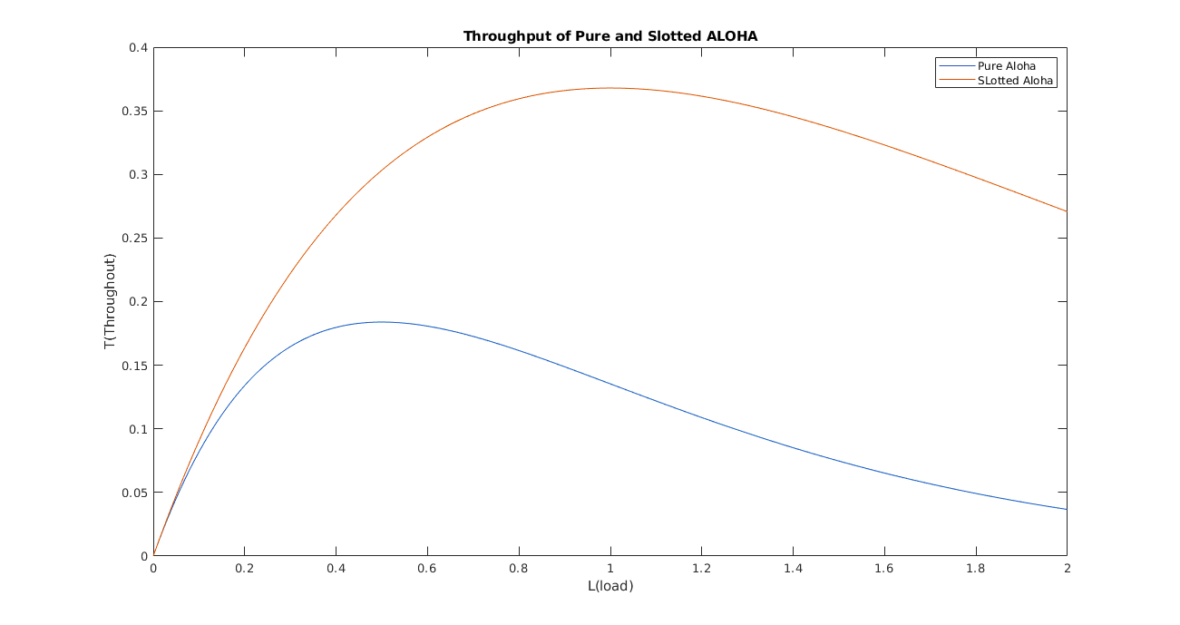
The maximum throughput of ‘pure ALOHA’ is 0.18 and that of ‘slotted ALOHA’ is 0.36.

Slide 20
Carrier Sense Multiple Access (CSMA)
In this protocol, a transmitter waits and also senses the channel information like transmission time and delays and makes a calculative transmission.
Random transmission periods if channel is sensed busy (Random backoff).
Works if all nodes are detectable by all other nodes (Hidden nodes). Some nodes may not collide with any other node or the information isn’t easily available.
A new node may just transmit without any wait time.
RTS (Request To Send) packet is sent by node before a node starts sending information.
CTS (Clear To Send) packet is sent by receiver if channel is free to send. (RTS-CTS Handshake).

Slide 21
Scheduling
In random access protocols, the transmission works if there is crowding, but not efficiently when length of transmission window of some user is large.
For this, scheduling is done, which is assigning different frequencies, time intervals, codes, etc. for similar type of users, which solves the issue of unbalanced transmission window lengths and caters to crowding.
It can be seen as a combination of both random access protocols and Multiple Access Protocols.

Slide 22
MULTIUSER CHANNELS
A multiuser channel refers to any channel that must be shared among multiple users.
The 2 types of multi-user channels are:
Downlink
Uplink
The downlink channel is also known as ‘Broadcast / Forward channel’ and the uplink channel is also known as ‘Multiple Access / Reverse channel’.

Slide 23
Downlink Channel
One transmitter sending to many receivers.
Total signaling dimensions and power of the transmitted signal must be divided among the different users.
Synchronization of different users is relatively easy since all signals originate from the same transmitter, although multipath in the channel can corrupt this synchronization.
Both signal and interference are distorted by the same channel.
Examples include radio and television broadcasting, transmission link from a base station to the mobile terminals in a cellular system.

Slide 24
Uplink Channel
Many transmitters sending signals to one receiver.
Each user has an individual power constraint associated with its transmitted signal.
Since the signals are sent from different transmitters, these transmitters must coordinate if signal synchronization is required.
Received powers associated with the different users will be different if their channel gains are different.
Examples include laptop wireless LAN cards transmitting to a wireless LAN access point, transmissions from mobile terminals to a base station in cellular systems.

Slide 25
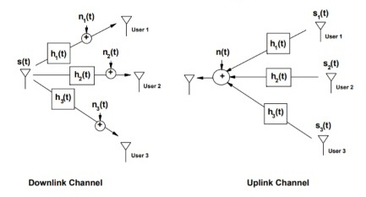
Block diagrams of uplink and downlink channels

Slide 26
Duplexing
In practical, we need channels which need two way transmission, i.e., uplink and downlink. But, we cannot achieve this on a single frequency band as there will be interferences which aren’t desired.
Thus, we choose frequency bands in such a way that there is no interference due to uplink over downlink, i.e., we choose orthogonal signalling dimensions to overcome this issue. This separation is called Duplexing.
Some methods are FDD (frequency division duplexing), TDD (time division duplexing), etc.

Slide 27
Channel Capacity
The multiuser channel capacity is characterized by a rate region, where each point in the region is a vector of achievable rates that can be maintained by all the users simultaneously with arbitrarily small error probability.
The union of achievable rate vectors under all multiuser transmission strategies is called the capacity region of the multiuser system.
The channel capacity is different for uplink channels and downlink channels due to the fundamental differences between these channel models.
In the analysis of channel capacity the downlink is commonly referred to as the broadcast channel (BC) and the uplink is commonly referred to as the multiple access channel (MAC)

Slide 28
Channel Model
We consider a BC consisting of one transmitter sending different data streams, also called independent information or data, to different receivers.
We initially focus on capacity regions for the two-user BC, which can then be generalised for any finite number of users
The two-user BC has one transmitter and two distant receivers receiving data at rate R_{k} , k = 1, 2. The channel power gain between the transmitter and kth receiver is g_{k} , k = 1, 2, and each receiver has AWGN of PSD N₀/2.
We define the effective noise on the kth channel as n_{k} = N₀/g_{k} , k = 1, 2, and we arbitrarily assume that n₁ ≤ n₂.

Slide 29
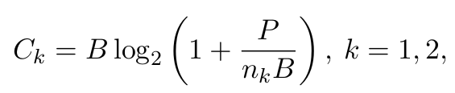
Channel Model for Downlink Channel Capacity
The channel gains or, equivalently, the effective noise of the users can be ordered makes the channel model a degraded broadcast channel, for which a general formula for channel capacity is known.
Let us denote the transmitter’s total average power and bandwidth by P and B, respectively.
Therefore, the set of simultaneously achievable rates (R₁,R₂) includes the pairs (C₁, 0) and (0,C₂), where C_{k} is the single-user capacity in bps for an AWGN channel,

Slide 30
Capacity in AWGN for BC
The set of achievable rate vectors of the AWGN BC under TD:
In TD, the transmit power P and bandwidth B are allocated to user 1 for a fraction τ of the total transmission time, and then to user 2 for the remainder of the transmission.

Slide 31
Channel Model for Downlink (Broadcast) Channel Capacity
Let P₁ and P₂ denote the average power allocated to users 1 and 2, respectively, over their assigned time slots. The average power constraint then becomes τP₁+(1−τ)P₂= P . The achievable rate region with TD and variable power allocation is then

Slide 32
Channel Model for Downlink (Broadcast) Channel Capacity
In FD the transmitter allocates P_{k} of its total power P and B_{k} of its total bandwidth B to user k. The power and bandwidth constraints require that P₁+P₂=P and B₁+B₂=B. The set of achievable rates for a fixed frequency division (B₁ , B₂) is thus
The FD achievable rate region is defined as the union of fixed FD rate regions over all bandwidth divisions:

Slide 33
Channel Model for Downlink (Broadcast) Channel Capacity
The achievable rate region for TD with unequal power allocation given by C_{TD,VP} is the same as the FD achievable rate region. This is seen by letting B_{i} = τ_{i}B and π_{i}=τ_{i}P_{i} , where τ₁ = τ and τ₂ = 1−τ . The power constraint then becomes π₁+π₂=P . Making these substitutions in C_{TD,VP} yields

Slide 34

Channel Model for Downlink (Broadcast) Channel Capacity
The two-user capacity region using superposition coding and successive interference cancellation is found to be the set of rate pairs
Assuming a total power constraint P , the multi-user extension to the two-user region is given by

Slide 35


Channel Model for Downlink (Broadcast) Channel Capacity
We define the sum-rate capacity of a BC as the maximum sum of rates taken over all rate vectors in the capacity region:
Sum-rate capacity is a single number that defines the maximum throughput of the system regardless of fairness in terms of rate allocation between the users.
In particular, it can be shown that sum-rate capacity is achieved on the AWGN BC by assigning all power P to the user with the highest channel gain or, equivalently, the lowest effective noise. Defining n_{min} = min_{k} n_{k} and g_{max} = max_{k} g_{k} , this implies that the sum-rate capacity C_{BCSR} for the K-user AWGN BC is given by

Slide 36
Channel Model for Downlink (Broadcast) Channel Capacity
CD for multiple users can also be implemented using DSSS, where the modulated data signal for each user is modulated by a unique spreading code, which increases the transmit signal bandwidth by approximately G, the processing gain of the spreading code.
For a total bandwidth constraint B, the information bandwidth of each user’s signal with these spreading codes is thus limited to B/N . The two-user achievable rate region with these spreading codes is then

Slide 37
Channel Model for Downlink (Broadcast) Channel Capacity
Important Observations:
We see that CD with orthogonal coding is the same as fixed FD with the bandwidth equally divided (B₁ = B₂ = B/2).
From C_{TD,VP}, TD with unequal power allocation can also achieve all points in this rate region.
Orthogonal CD with Walsh-Hadamard codes achieves a subset of the TD and FD achievable rate regions

Slide 38
Channel Model for Downlink (Broadcast) Channel Capacity
DSSS with non-orthogonal spreading codes:
In these systems interference between users is attenuated by the code cross correlation. Thus, if interference is treated as noise, its power contribution to the SIR is reduced by the square of the code cross correlation.
We will assume that spreading codes with a processing gain of G reduce the interference power by 1/G. the two-user BC rate region achievable through non-orthogonal DSSS and successive interference cancellation is given by

Slide 39
Channel Model for Downlink (Broadcast) Channel Capacity
With non-orthogonal coding and no interference cancellation, the receiver treats all signals intended for other users as noise, resulting in the achievable rate region
G = 1 maximizes this rate region, and the rate region decreases as G increases.

Slide 40
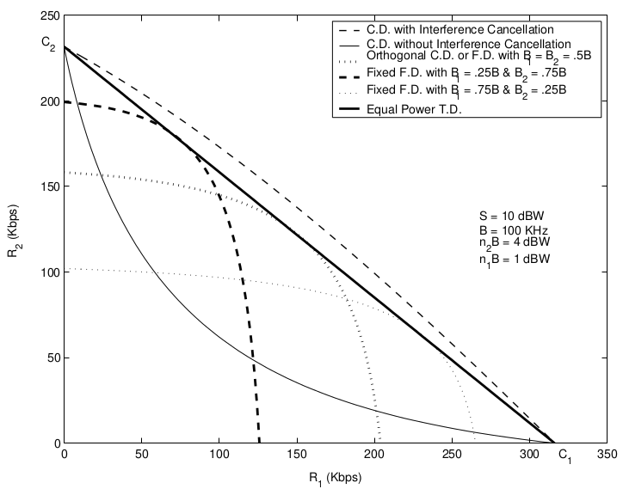
Two-User Capacity Region: 3 dB SNR Difference.

Slide 41
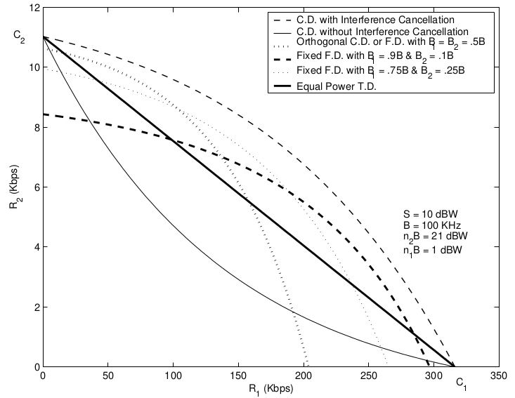
Two-User Capacity Region: 20 dB SNR Difference

Slide 42
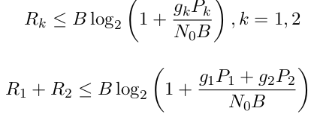
Uplink (Multiple Access) Channel Capacity in AWGN
The MAC consists of K transmitters, each with power P_{k}, sending to a receiver over a channel with power gain g_{k} .
The two-user multiaccess capacity region is the closed convex hull of all vectors (R₁,R₂) satisfying the following constraints.

Slide 43

Uplink (Multiple Access) Channel Capacity in AWGN
The first constraint is just the capacity associated with each individual channel. The second constraint indicates that the sum of rates for all users cannot exceed the capacity of a “superuser” with received power equal to the sum of received powers from all users. For K users, the region becomes
Thus, the above region indicates that the sum of rates for any subset of the K users cannot exceed the capacity of a superuser with received power equal to the sum of received powers associated with this user subset.

Slide 44

Uplink (Multiple Access) Channel Capacity in AWGN
As with the sum-rate capacity of the BC, the MAC sum-rate also measures the maximum throughput of the system regardless of fairness, and is easier to characterize than the K-dimensional capacity region.
This result can be logically explained as each user in the MAC has an individual power constraint, so not allowing a user to transmit at full power wastes system power. By contrast, the AWGN BC sum-rate capacity is achieved by only transmitting to the user with the best channel. However, since all users share the power resource, no power is wasted in this case.

Slide 45
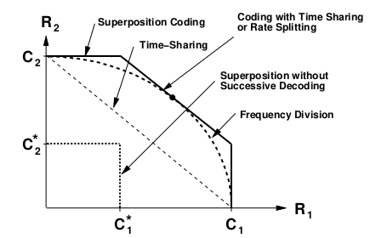
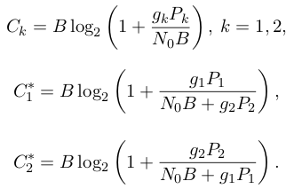
Two-User MAC Capacity Region.
The MAC capacity region for two users is shown in figure below, where C_{k} and C_{k}∗ are given by

Slide 46

Uplink (Multiple Access) Channel Capacity in AWGN
With FD, the rates depend on the fraction of the total bandwidth that is allocated to each transmitter. Letting B₁ and B₂ denote the bandwidth allocated to each of the two users, we get the achievable rate region.
Clearly this region dominates TD, since setting B₁ = τB and B₂ = (1 − τ )B in the equation given below has R₁ > τC₁ and R₂ > (1 − τ )C₂.

Slide 47

Uplink (Multiple Access) Channel Capacity in AWGN
As with the BC, we can obtain the same achievable rate region with TD as with FD by efficient use of the transmit power.
Considering the constraints P₁ and P₂ to be average power constraints, then since user k only uses the channel a fraction τ k of the time, its average power over that time fraction can be increased to P_{k}/τ_{k} .
The rate region achievable through variable-power TD is then given by

Slide 48
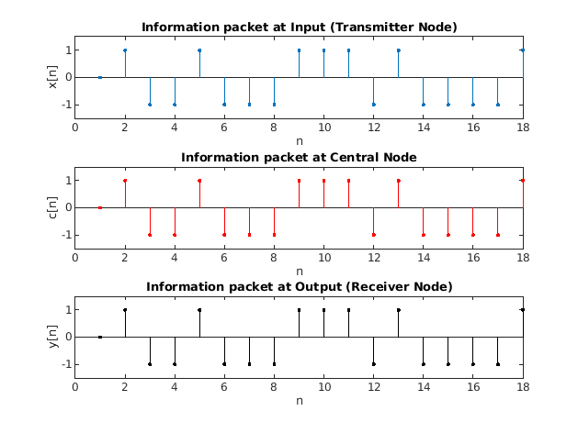
An example for Uplink-Downlink BPSK mapped system (Noiseless)

Slide 49
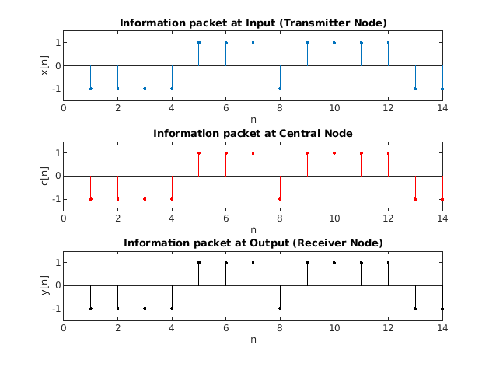
An example for Uplink-Downlink BPSK mapped system (AWGN)

Slide 50
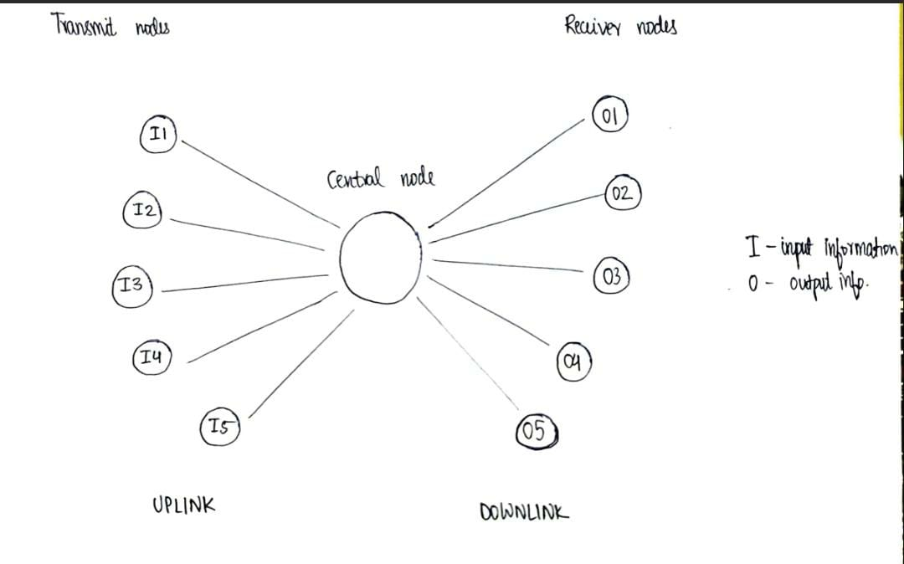
Modelled system

Slide 51
GitHub Repository link for all MATLAB Codes and Plots
https://github.com/Sasanka-GRS/Communication-Theory-Project

